Slide 1

AC
Automatic Correction

Slide 2
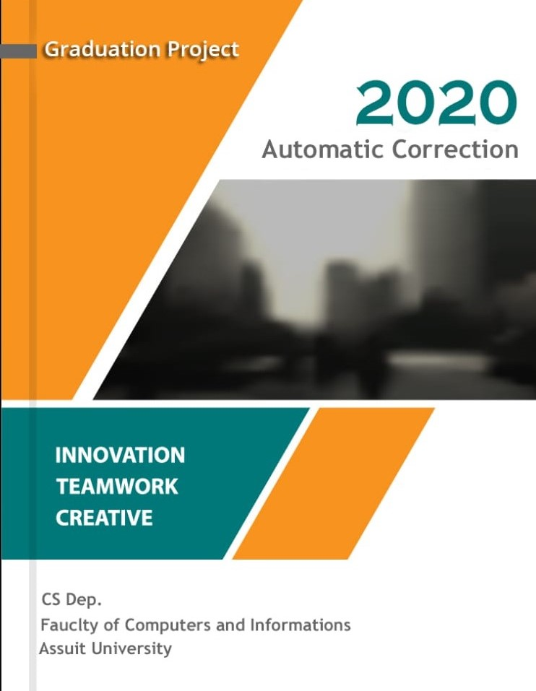

Slide 3
Problem Statement
multiple-choice questions
educational system

Slide 4
Methodology and steps
Take the image with run the mobile application and send the image to the server socket then the python code will run
Do Pre Processing Convert the colored image to gray image…do Gaussian Blure and canny edge detection
Find the Biggest counters in the image >>the border of the questions
Do Perspective Transform to the biggest counter>> detect the border of images and focus the view on it
Do the Adaptive thresholding and binery thresholding to the image
Divide the image in rows and columns
Count the non zero in every circle and find the max in every row >>> then get the result
Read the image and run the function to get the final result

Slide 5
What is a computer vision ?
Computer vision is concerned with the automatic extraction, analysis and understanding of useful information from a single image or a sequence of images. It involves the development of a theoretical and algorithmic basis to achieve automatic visual understanding.

Slide 6
What computer vision Application ?
Automatic inspection, e.g., in manufacturing applications.
Assisting humans in identification tasks, e.g., a species identification system.
Controlling processes, e.g., an industrial robot.
Detecting events, e.g., for visual surveillance or people counting, e.g., in the restaurant industry.
Interaction, e.g., as the input to a device for computer-human interaction.
Modeling objects or environments, e.g., medical image analysis or topographical modeling.
Navigation, e.g., by an autonomous vehicle or mobile robot.
Organizing information, e.g., for indexing databases of images and image sequences.

Slide 7

Open computer vision library
OpenCV (Open Source Computer Vision Library) is an open source computer vision and machine learning software library. OpenCV was built to provide a common infrastructure for computer vision applications and to accelerate the use of machine perception in the commercial products.

Slide 8
Why we used OpenCV ?
First and foremost, OpenCV is available free of cost
It has C++, Python, Java and MATLAB interfaces and supports Windows, Linux, Android and Mac OS.
OpenCV library can be used to perform multiple operations on videos and images

Slide 9
Grayscale image in openCV
A grayscale image is one in which the value of each pixel is a single sample representing only an amount of light; that is, it carries only intensity information. Grayscale images, a kind of black-and-white or gray monochrome, are composed exclusively of shades of gray. The contrast ranges from black at the weakest intensity to white at the strongest.

Slide 10
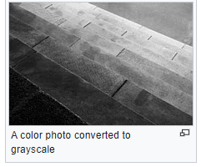
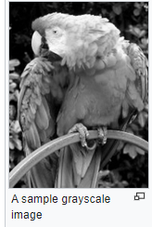

Slide 11
Gaussian blur in openCV
A Gaussian blur (also known as Gaussian smoothing) is the result of blurring an image by a Gaussian function (named after mathematician and scientist Carl Friedrich Gauss). It is a widely used effect in graphics software, typically to reduce image noise and reduce detail

Slide 12
Canny edge detector
The Canny edge detector is an edge detection operator that uses a multi-stage algorithm to detect a wide range of edges in images. It was developed by John F. Canny in 1986. Canny also produced a computational theory of edge detection explaining why the technique works.

Slide 13
Process of Canny edge detection algorithm
Apply Gaussian filter to smooth the image in order to remove the noise.
Find the intensity gradients of the image.
Apply non-maximum suppression to get rid of spurious response to edge detection.
Apply double threshold to determine potential edges.
Track edge by hysteresis: Finalize the detection of edges by suppressing all the other edges that are weak and not connected to strong edges.

Slide 14
What is thresholding?
The simplest thresholding methods replace each pixel in an image with a black pixel if the image intensity is less than some fixed constant T (that is, <T), or a white pixel if the image intensity is greater than that constant. In the example image on the right, this results in the dark tree becoming completely black, and the white snow becoming completely white.

Slide 15
What is NumPy?
NumPy is a python library used for working with arrays.
It also has functions for working in domain of linear algebra, fourier transform, and matrices.
NumPy was created in 2005 by Travis Oliphant. It is an open source project and you can use it freely

Slide 16
Why Use NumPy ?
NumPy aims to provide an array object that is up to 50x faster that traditional Python lists.
The array object in NumPy is called ndarray, it provides a lot of supporting functions that make working with ndarray very easy.
Arrays are very frequently used in data science, where speed and resources are very important.[10]

Slide 17
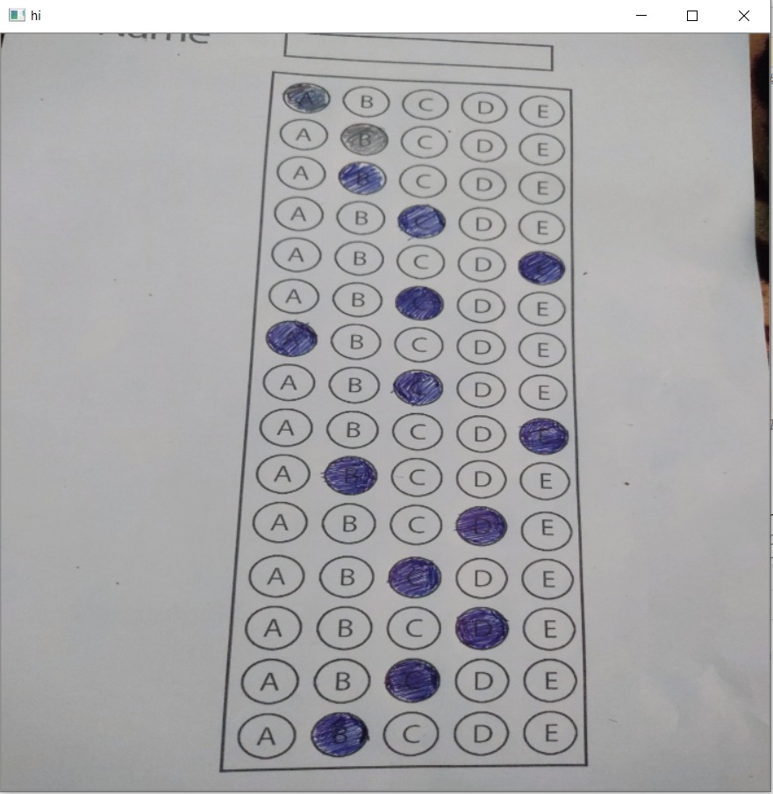
How our modle work
- We need to get bubble sheet test image that we are going to grade for correctness so that we load our image from gallery or taken by camera.

Slide 18
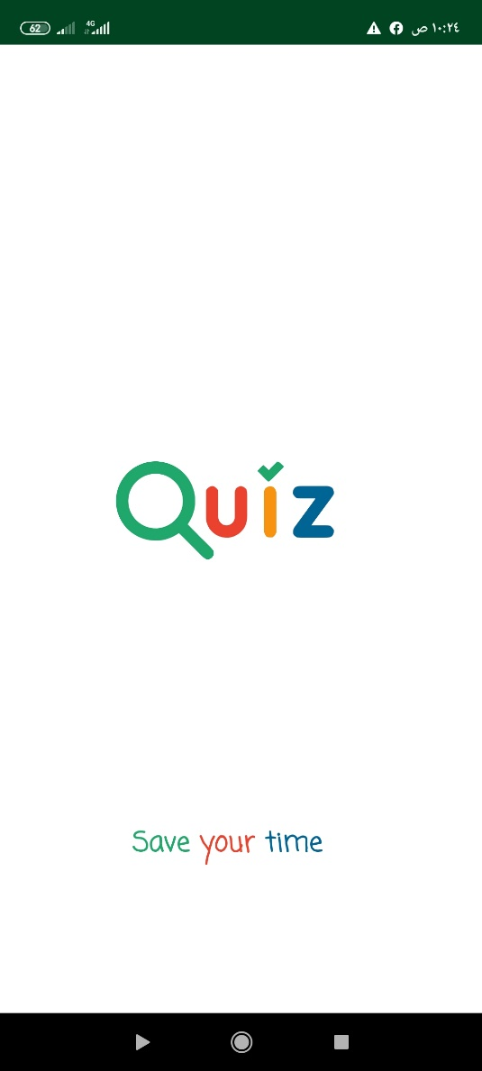
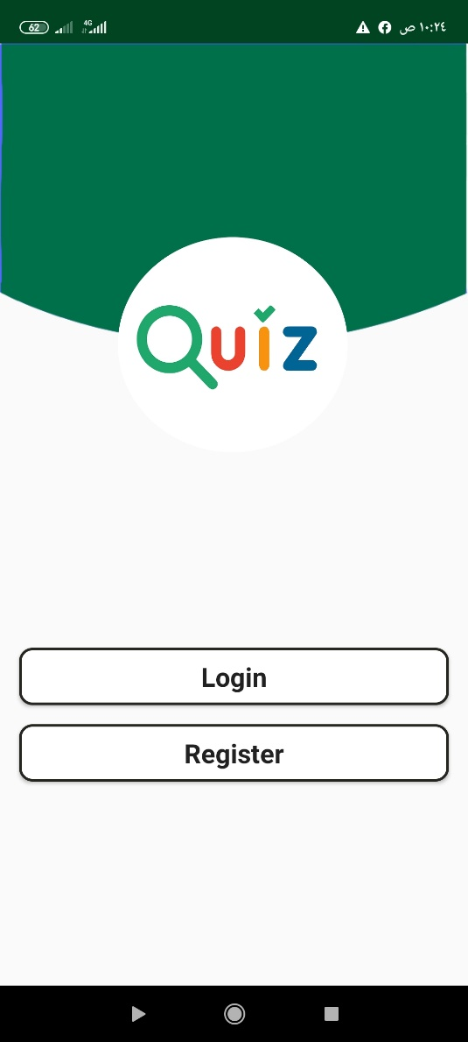
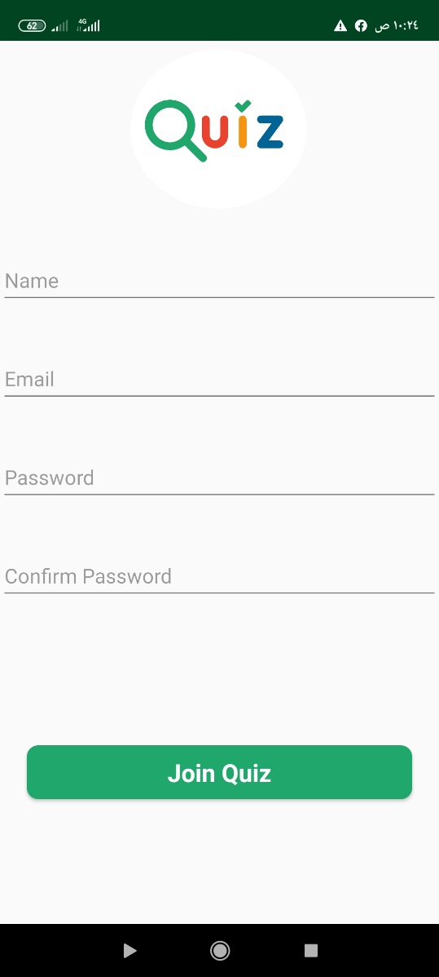
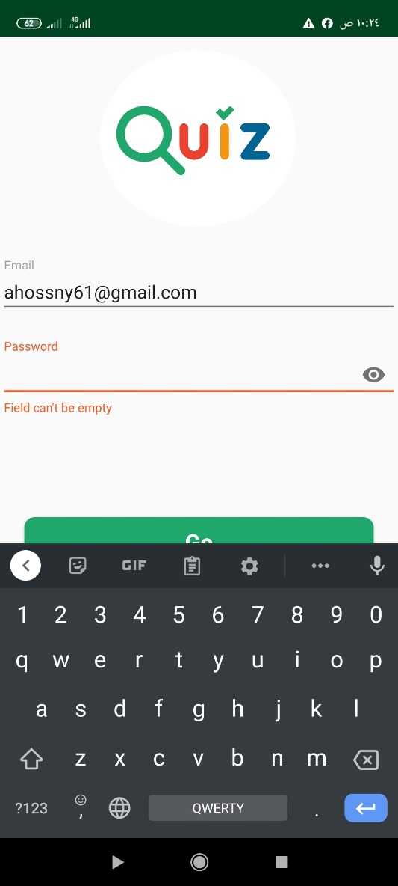
The mobile App

Slide 19
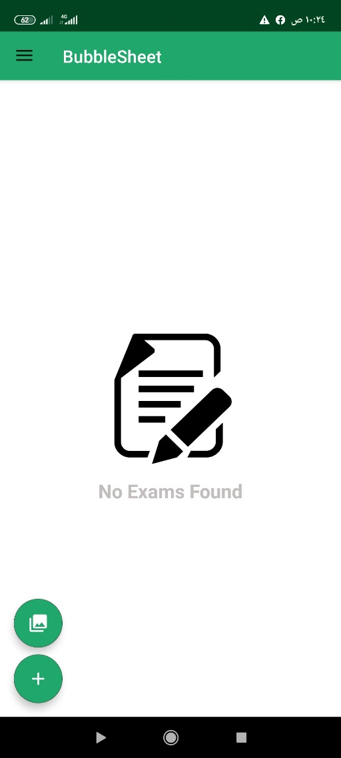
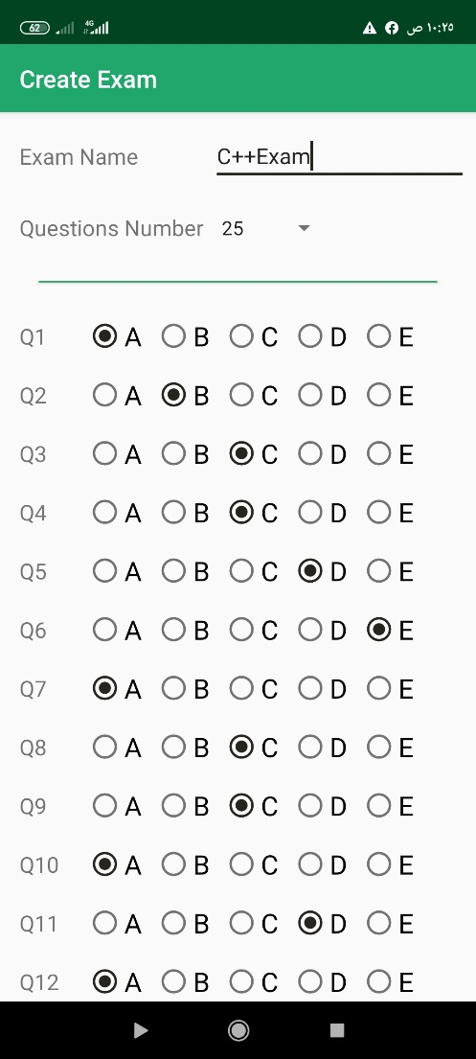
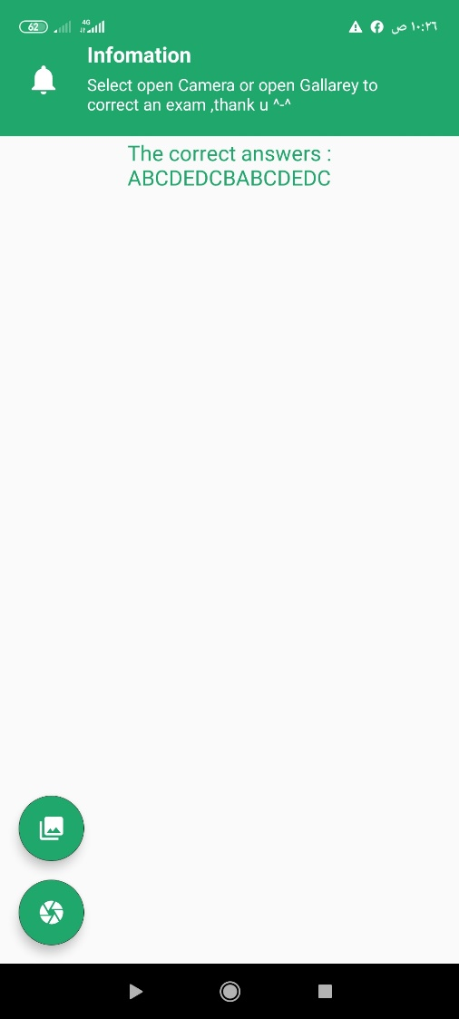

Slide 20
Second Step
After take the image we compress the image to send it faster to the server socket …..the server socket receive the image and save it in a specific folder then the process function on the image

Slide 21
Then the image sent to the server to preprocess.
ON SERVER :
First compress the image to reduce the size by
img = cv2.resize(img, (widthImg, heightImg))
followed by converting it to grayscale ,and blurring it to reduce high frequency noise.
imgGray = cv2.cvtColor(img, cv2.COLOR_BGR2GRAY) # CONVERT IMAGE TO GRAY SCALE

Slide 22
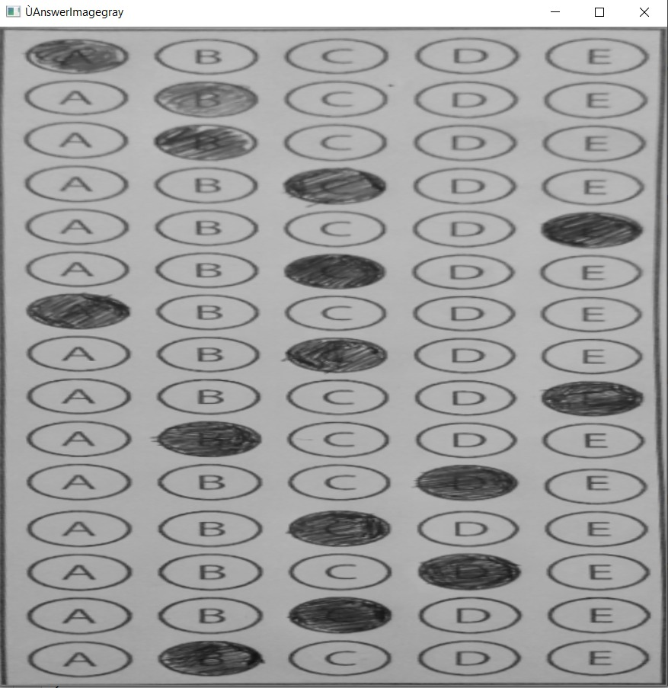
- imgBlur = cv2.GaussianBlur(imgGray, (5, 5), 1) # ADD GAUSSIAN BLUR

Slide 23
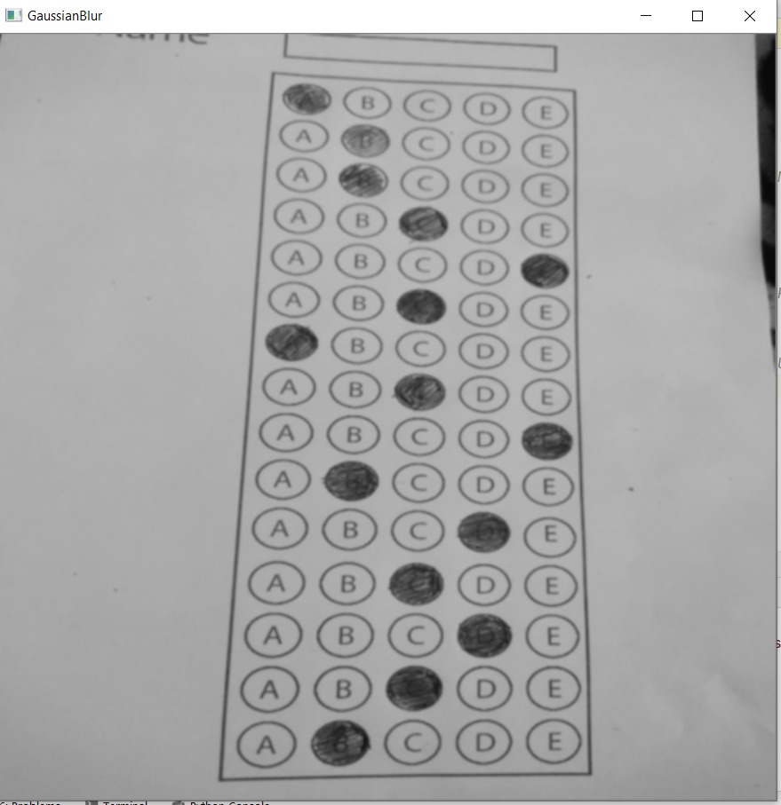

Slide 24
We then apply the Canny edge detector to find the edges/outlines of the exam.
imgCanny = cv2.Canny(imgBlur, 10, 70) # APPLY CANNY
Below I have included a screenshot of our exam after applying edge detection:

Slide 25
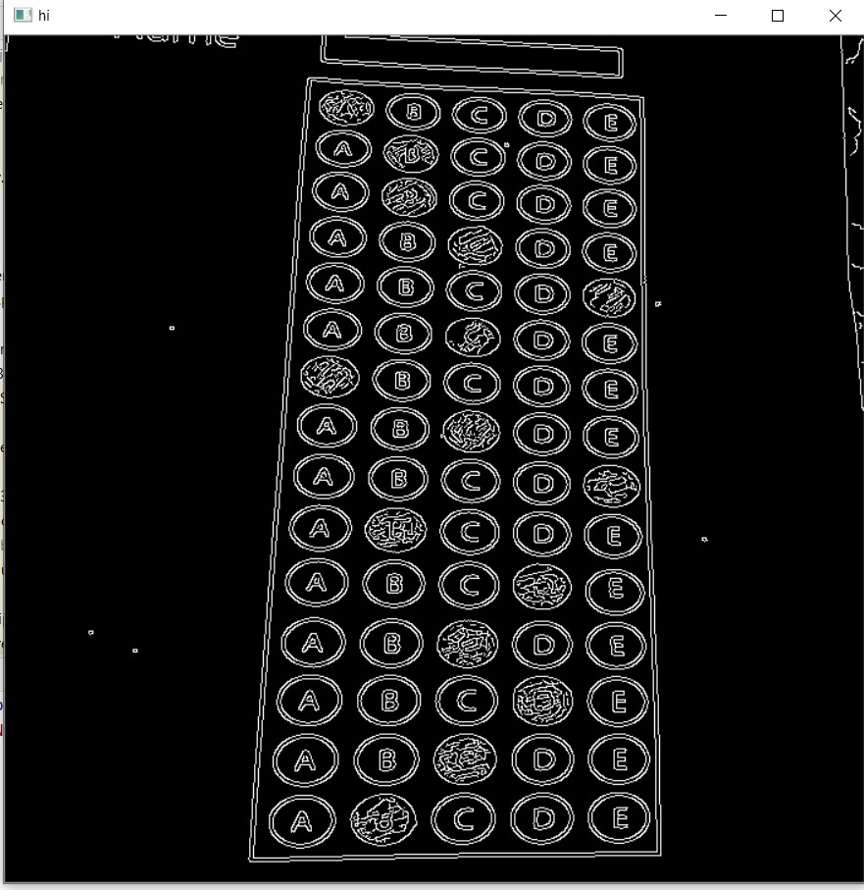
Now that we have the outline of our exam, we apply the cv2.findContours function to find the lines that correspond to the exam itself.

Slide 26
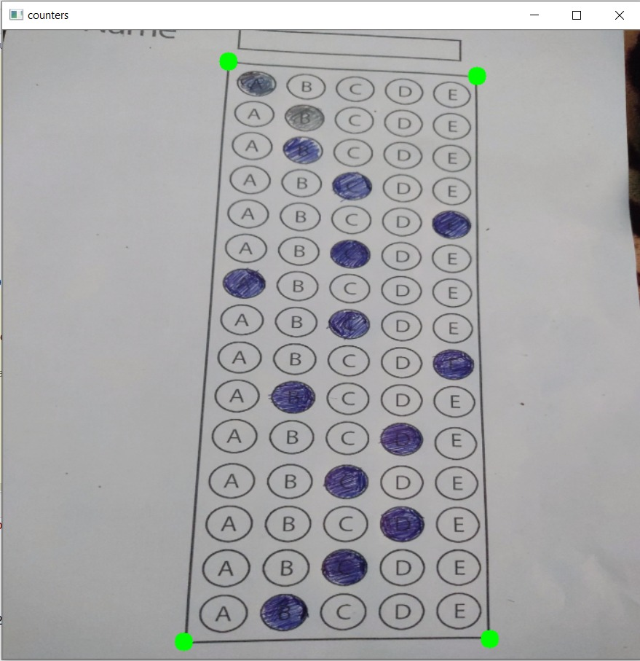
Now that we have the outline of our exam, we apply the cv2.findContours function to find the lines that correspond to the exam itself.

Slide 27
We do this by sorting our contours by their area (from largest to smallest). This implies that larger contours will be placed at the front of the list, while smaller contours will appear farther back in the list.
We make the assumption that our exam will be the main focal point of the image, and thus be larger than other objects in the image. This assumption allows us to “filter” our contours, simply by investigating their area and knowing that the contour that corresponds to the exam should be near the front of the list.
However, contour area and size is not enough — we should also check the number of vertices on the contour.
we make a check to see if our approximated contour has four points, and if it does, we assume that we have found the exam.

Slide 28
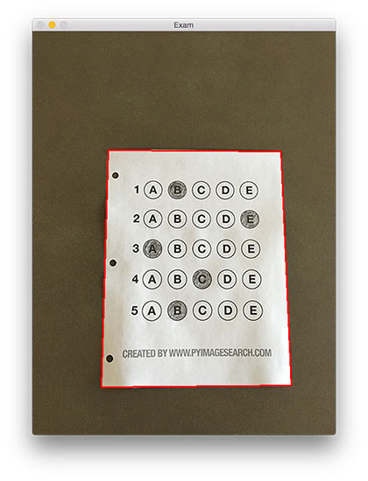
Now that we have used contours to find the outline of the exam, we can apply a perspective transform to obtain a top-down, birds-eye-view of the document:
Applying process of Adaptive and binery thresholding/segmenting the foreground from the background of the image:
imgThresh = cv2.threshold(imgWarpGray, 170, 255, cv2.THRESH_BINARY_INV)
After applying Otsu’s thresholding method, our exam is now a binary image:

Slide 29
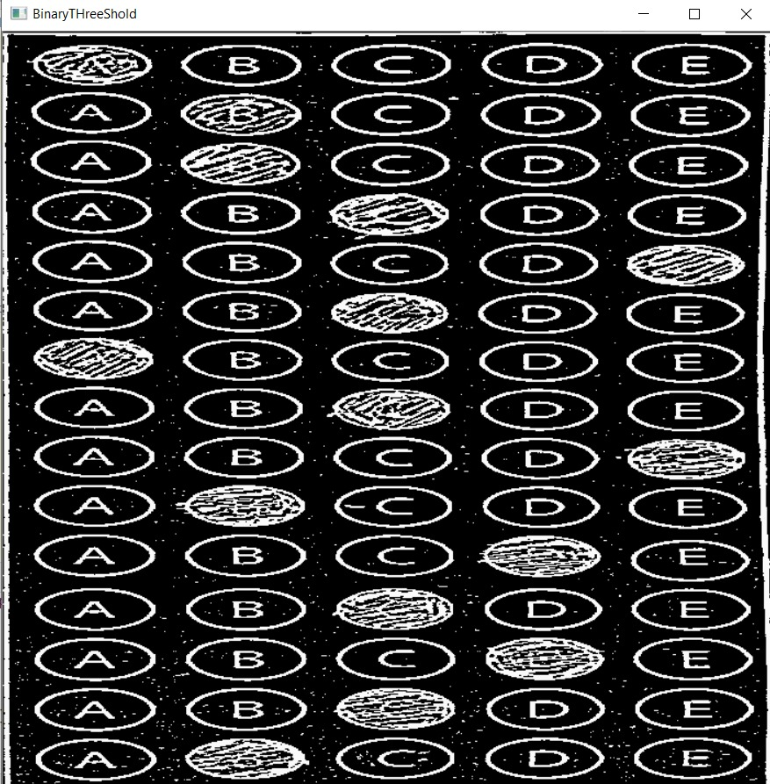
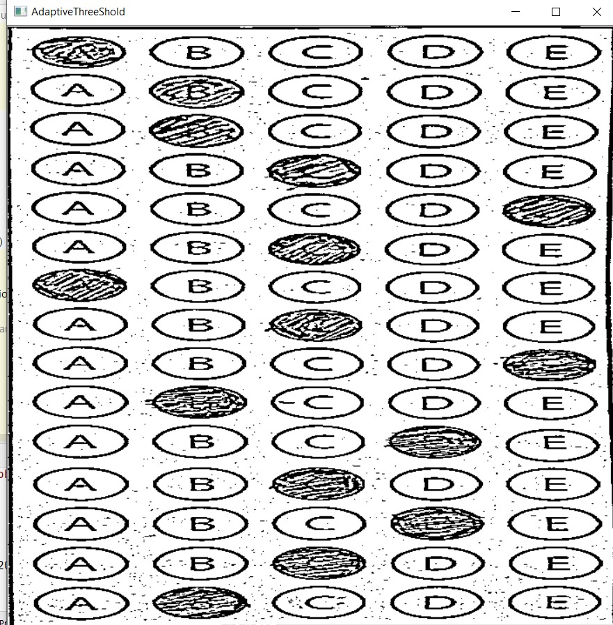

Slide 30
For each of these pixels, we compute the bounding box ( which also allows us to compute the aspect ratio, or more simply, the ratio of the width to the height . totalPixels = cv2.countNonZero(image)
Then FIND THE USER ANSWERS AND PUT THEM IN A LIST
We can now move on to the “grading” portion of our OMR system:

Slide 31
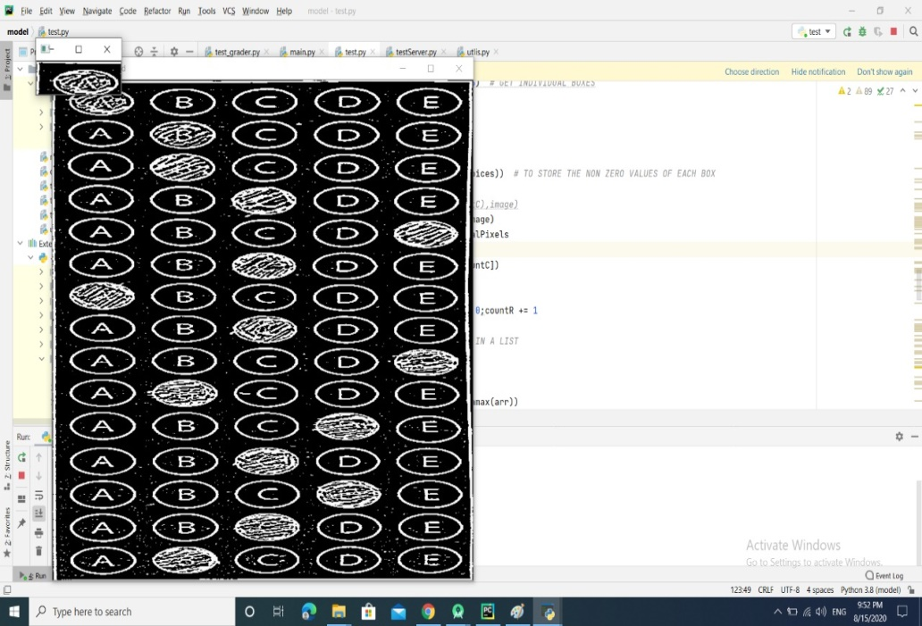
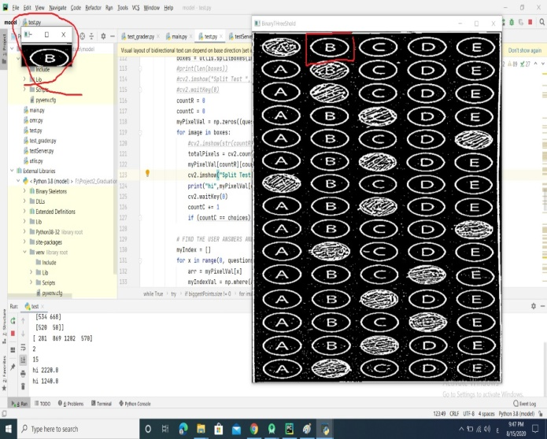

Slide 32
Return the result to the App
We finally get the student’answer then the server socket will send back the result to the mobile app and show the grade to the screen

Slide 33
Based on whether the test taker was correct or incorrect yields which color is drawn on the exam. If the test taker is correct, we’ll highlight their answer in green. However, if the test taker made a mistake and marked an incorrect answer, we’ll let them know by highlighting the correct answer in red:
Finally, our last code block handles scoring the exam and sending to our android application and displaying the results to our screen:

Slide 34
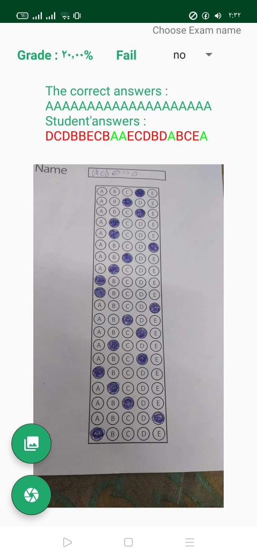

Slide 35
Tools identification
(1) Python programming language
(2) server socket
(3) Spyder
(4) Java programming languages
(5) Android studio
(6) netbeens

Slide 36
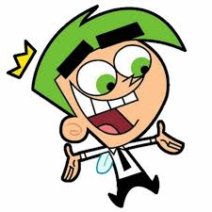
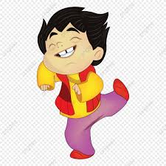
The End

